Slide 1
Reinforcement Learning
Ren Bo Hu
2018.06.12

Slide 2

Origin
How do we learn?
Action → Reward → Learn → Action…
Reinforcement Learning
Q-Learning

Slide 3
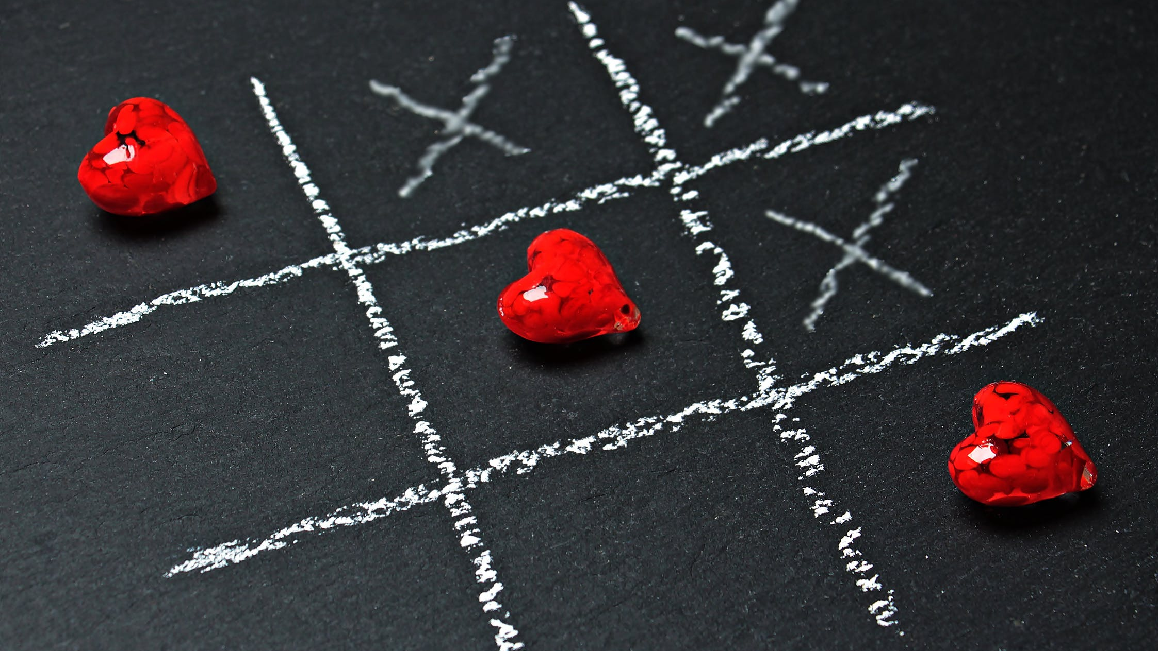
Board game
Easy to get state
Easy to get reward
Take Tic Tac Toe as an example
Samll Board(3*3)
No much possible state

Slide 4
Q-Learning
Initialize Q(s,a)
Initialize state
Choose action at this state(by Q(s,a))
Take action
Get reward and next_state
Update Q(s,a) = reward + gamma*Max{Q(next_state,)}
If done Goto 2.
Goto 3.

Slide 5
Question. How many state do we have?
255168 different kinds of state (from wikipedia)
Every state have 9 kinds of action
We have to use about 10MB of disk space to keep our Q table
How about Go?
3³⁶¹ different kinds of state(board size = 19*19) ≈ 1.7 * 10¹⁷²
Google DeepMine publish in Nature on 26th February 2015 (Atari 2600)

Slide 6
DQN Deep Reinforcement Learning
Ren Bo Hu
2018.06.12

Slide 7
Different between RL and DQN
Q(s,a) become Deep Neural Networks
Input: Now state
Output: Every action you take, how many reward you will get
Memory
You can remember what you have done before.
Another Deep Neural Networks
To cut off the connection between each data
Also represent out old neuron

Slide 8
Tic Tac Toe

Slide 9
Step.1
Creat two Neural Networks
Complete connection
Input: [None,9] State
Hidden: [None,52]
Output: [None,9] Reward

Slide 10
Step.2
Choose action @Training
90% choose the best reward’s action
10% random choose action
Winner get reward*(9-step)
Loser get reward*(9-step)*(-1)

Slide 11
Step.3
Training Neural Network
Store the data=[state,action,reward]
Train after store every 200 data
Try to minimum the cost = (actual reward – reward from neural network)²
or (reward from old neural network– reward from new neural network)²
Copy new net’s weight to old one every 100 data

Slide 12
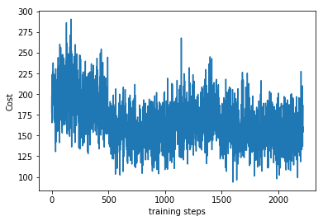
Step.4
Play with others
Black(use the network before) v.s. White(just random pick the action)
Use winning percentage to judge the performance of the learning
Winning percentage of black will be about 60% if always let black one goes first

Slide 13
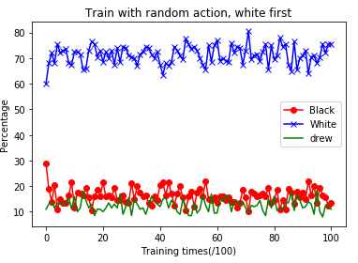
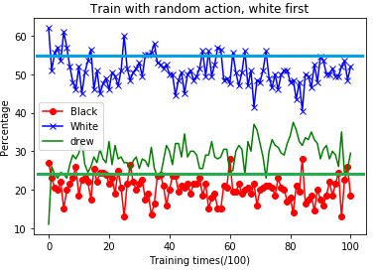
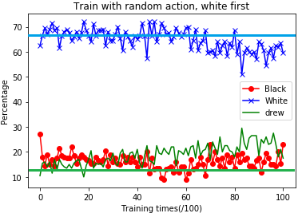
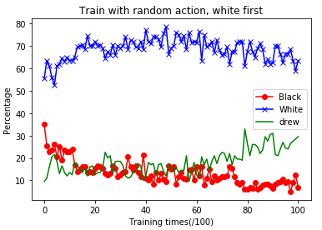
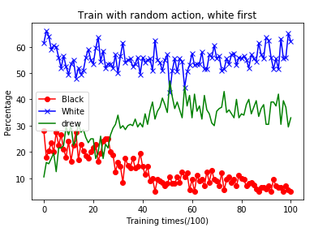
Result
Learning rate = 0.0000005 0.000001
Learning rate = 0.000003 0.00001 0.00005

Slide 14
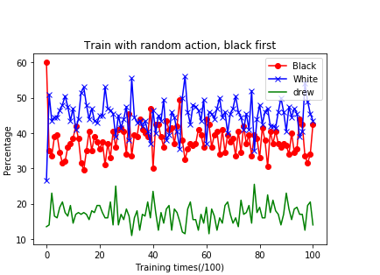
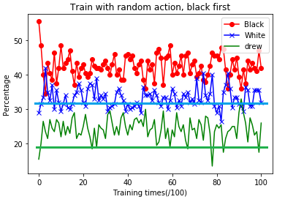
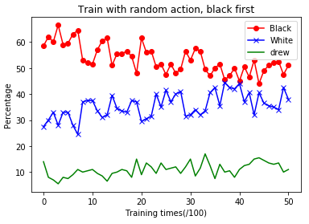
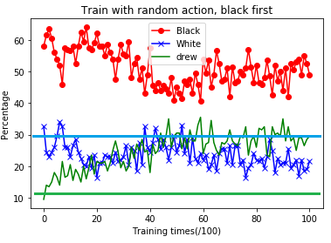
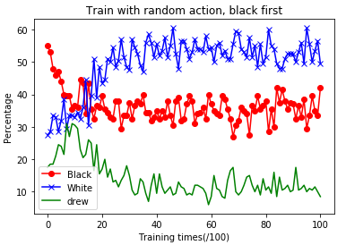
Result
Learning rate = 0.0000005 0.000001
Learning rate = 0.000003 0.00001 0.00005

Slide 15
Future
Try different module of Neural Network / Cost function
Play with human and learn from it
Do not need to try any possible
AlphaGo / AlphaGo Zero / AlphaGo Master(Monte Carlo tree search)

Slide 16
Thank you

